Slide 1

IoT-Based Patient Safety Analytics
By
Syed muhammad yaaman

Slide 2
Project Overview
Analyze global patient safety indicators
• Use public health dataset
• Apply data analytics and regression
• Demonstrate IoT-cloud concept

Slide 3
Dataset Description
• Source: Global Patient Safety Observatory
• Format: CSV
• Records: Multiple countries & years
• Key fields: Location, Period, Indicator, Value

Slide 4
Exploratory Data Analysis (EDA)
• Checked missing values
• Analyzed trends over time
• Visualized patient safety indicators
• Identified data patterns

Slide 5
Regression Model
• Built simple regression model
• Period as input feature
• Patient safety value as output
• Used for trend prediction

Slide 6
IoT & Cloud Integration
• Healthcare devices generate data
• Data stored on AWS S3 cloud
• Data analyzed using notebooks
• Supports smart healthcare decisions

Slide 7
Results & Insights
• Patient safety trends identified
• Data-driven understanding
• Supports healthcare planning

Slide 8
Conclusion
• Project demonstrates IoT + analytics
• Public health data successfully analyzed
• Cloud integration shown using AWS

Slide 9


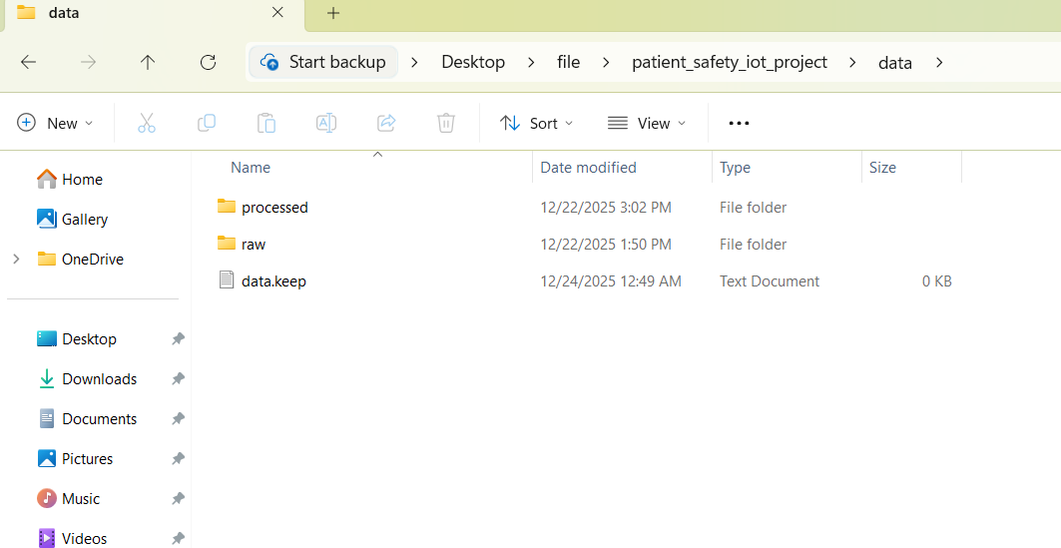
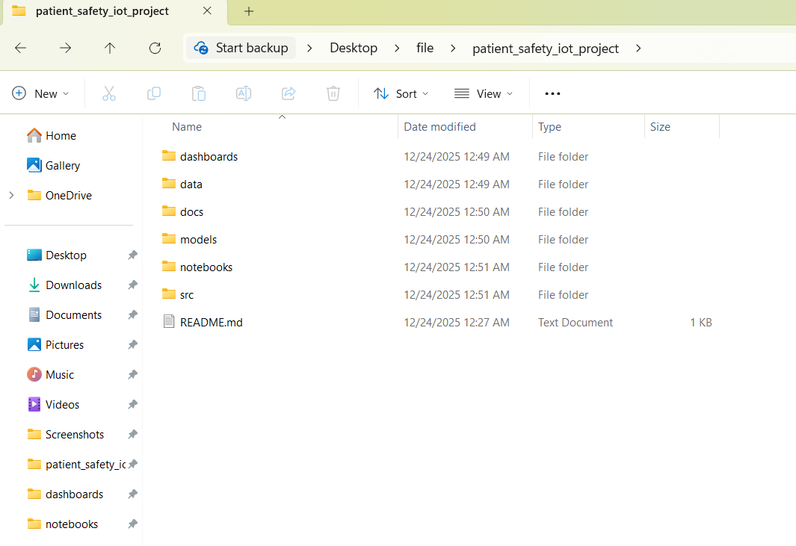



Files and folder layout

Slide 10
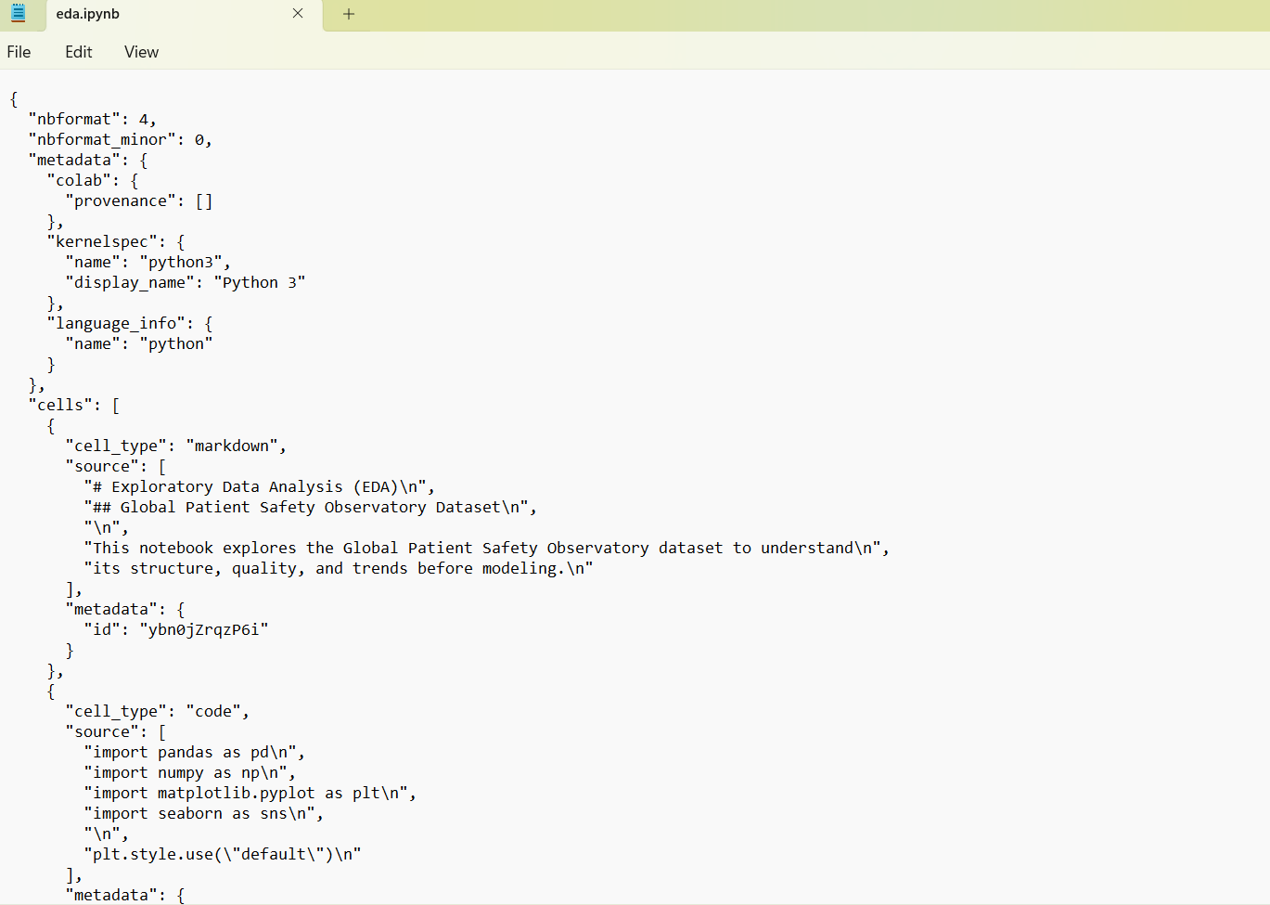
Eda

Slide 11
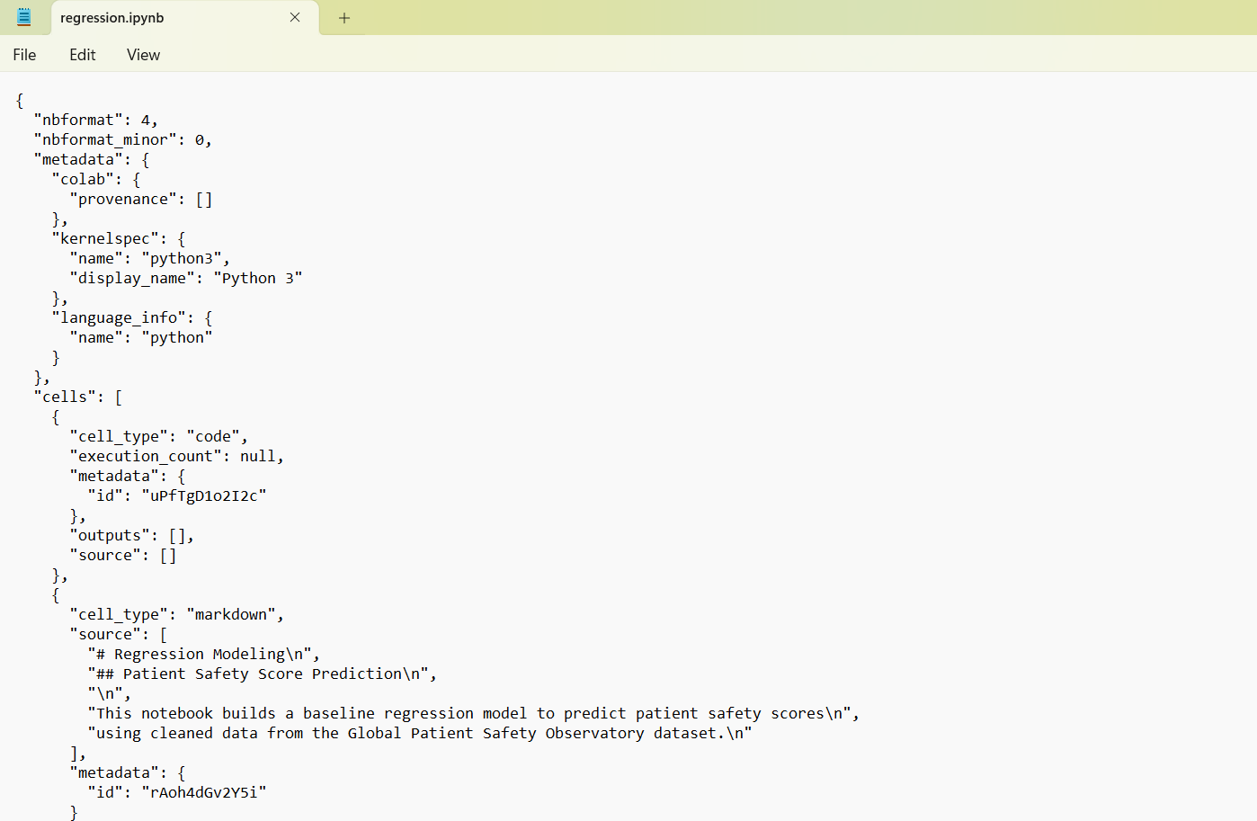
Regression model

Slide 12
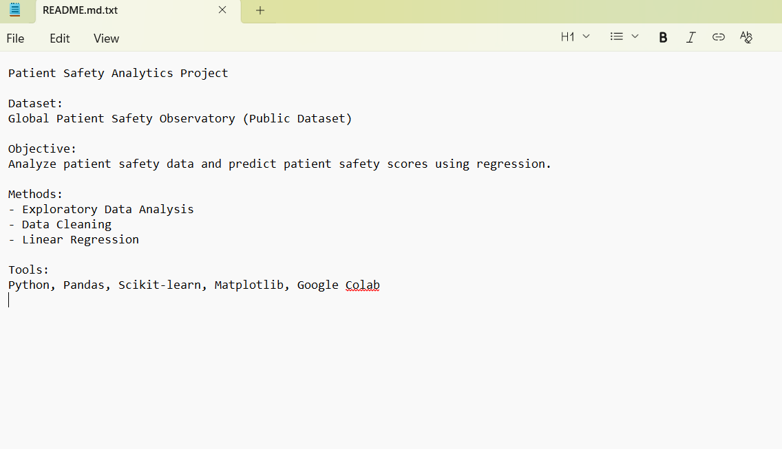
readme.md

Slide 13
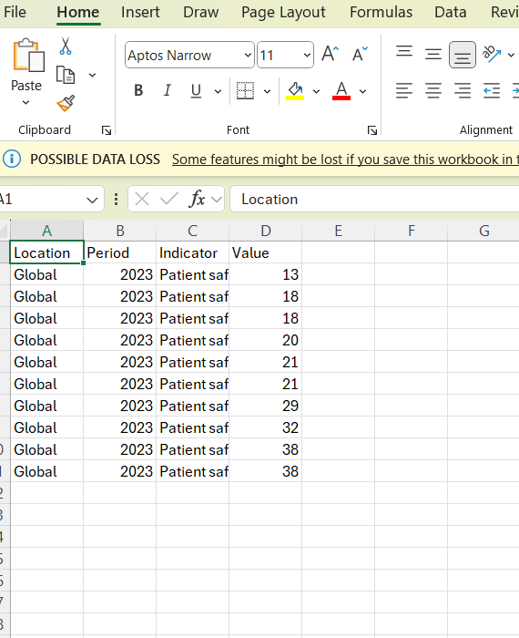
Processed data

Slide 14
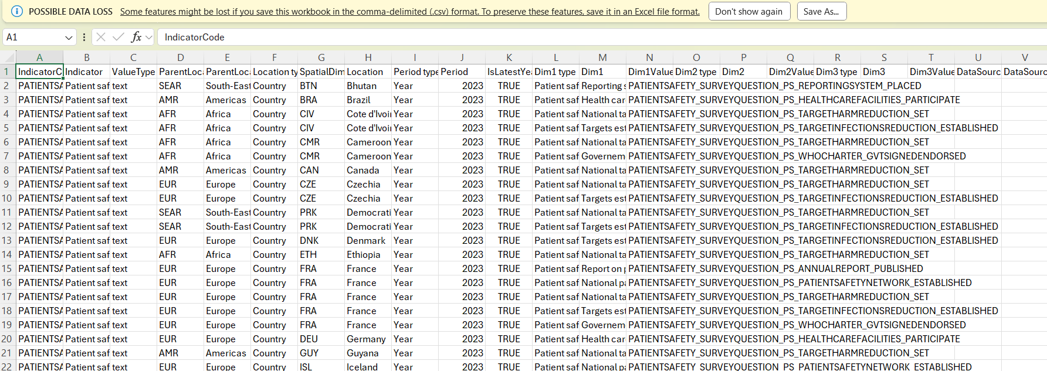
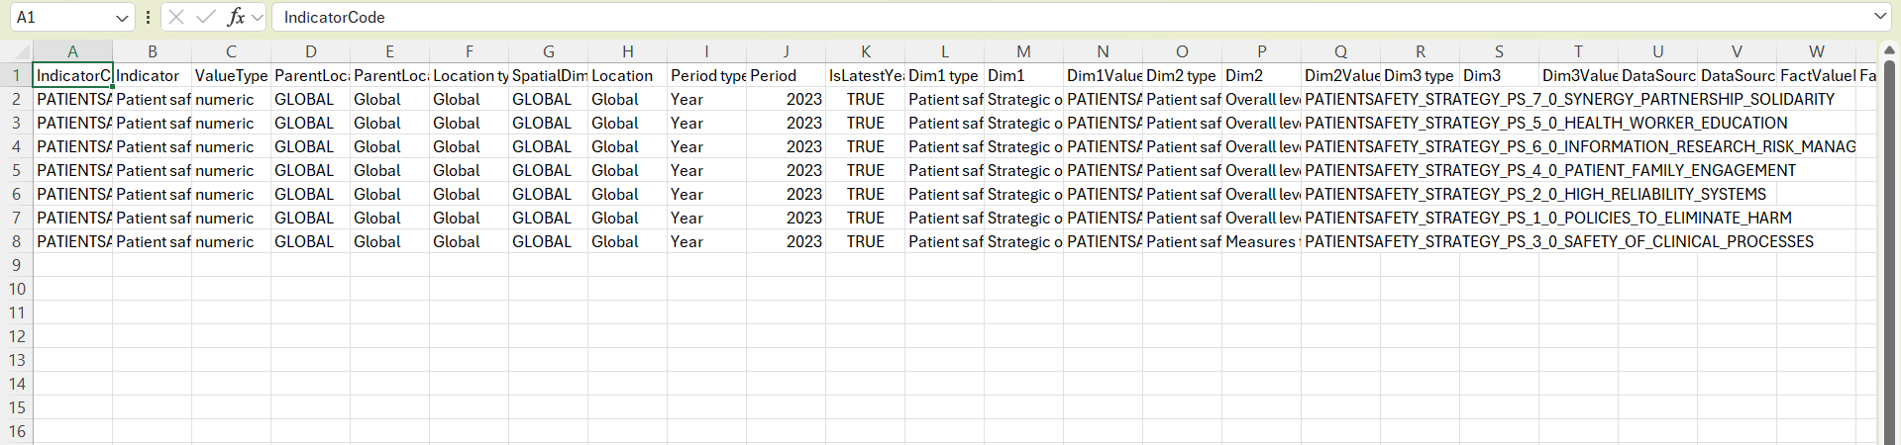
Raw data

Slide 15
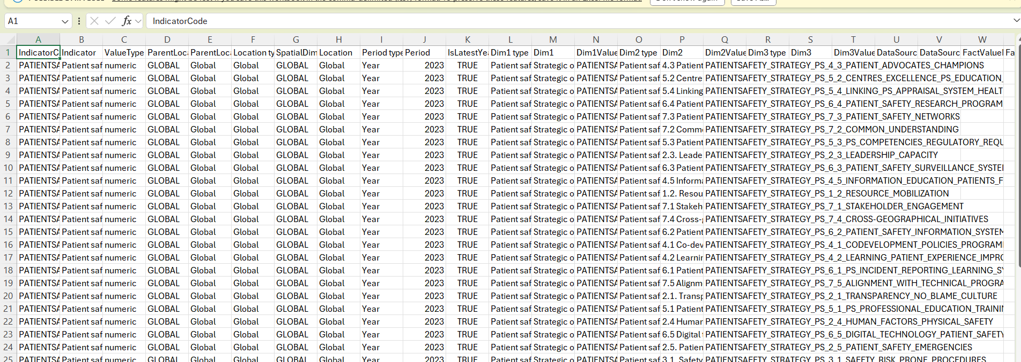
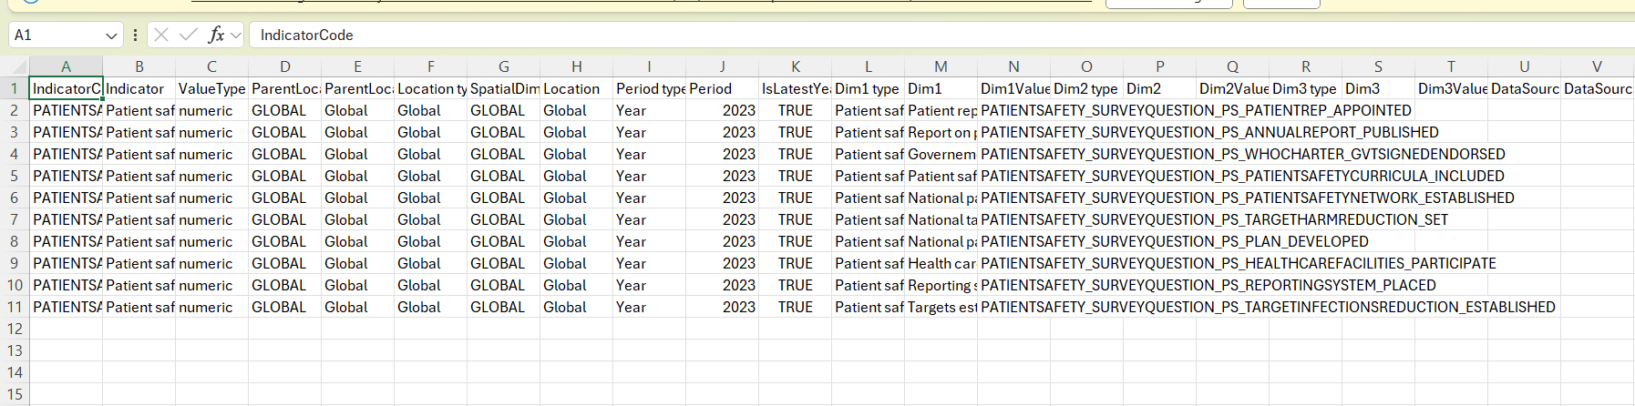
Raw data

